Slide 1


JAVA PROGRAMMING PROJECT
Smart Music Playlist Manager
A simple Java app to organize songs, create custom playlists, and search for tracks quickly.
PRESENTED BY
Srihitha
Radhika
2620080034
2620030258

Slide 2

Project Overview & Goals
An easy way to manage and play your favorite songs
Create Playlists
Search Songs
Group songs by mood, artist, or music style.
Find any song quickly by name or singer.
Why We Made This
To help users organize songs easily, group them by genre, search instantly, and practice core Java programming concepts in a real project.
Sort & Mix
Total Playing Time
Mix up song order or sort by length and title.
Automatically calculate how long a playlist will play.

Slide 3
The Problem & Our Solution
Fixing messy music lists using simple Java features
Common Problems
How Java Helps
Messy Music Lists: Hard to find and group mixed-up audio files.
Objects: Store title, artist, and length neatly together.
Slow Searching: Looking line-by-line takes too long in big lists.
HashMaps: Find any song instantly by title or artist.
Duplicate Songs: Same song saved multiple times wasting space.
LinkedLists: Add, remove, and reorder songs smoothly.
No Playing Time: Hard to know total playlist duration manually.
Tables: Show clear list views with song times and details.

Slide 4
How the Program Works
Three easy steps from adding songs to viewing playlists
STEP 01
STEP 02
STEP 03
Add Song Info
Organize & Store
Display Playlist
Type in the song title, artist name, music style, and length in seconds.
The system checks for duplicates, sorts songs, and builds fast search links.
Print a clean table of songs along with the total playing time.

Slide 5
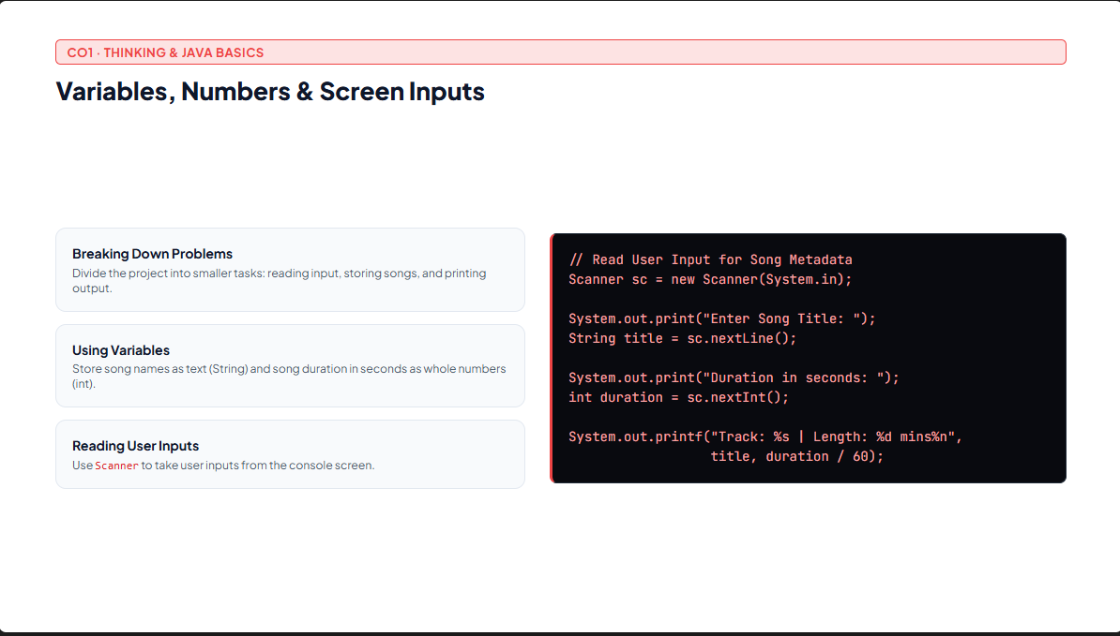

Slide 6
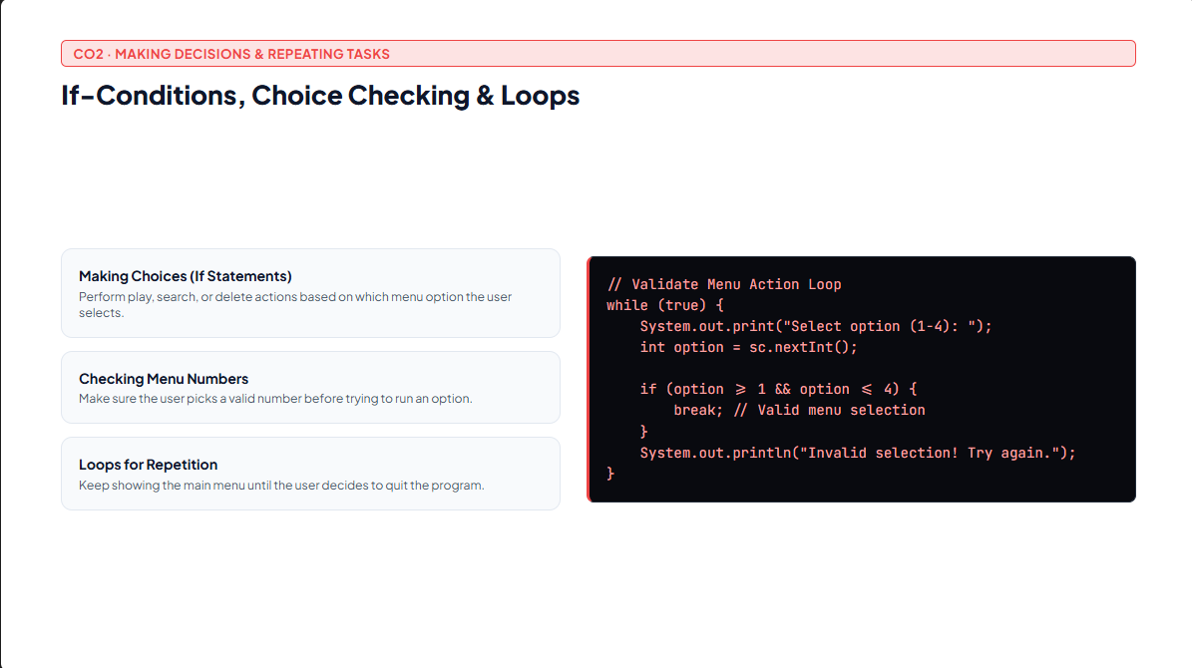

Slide 7
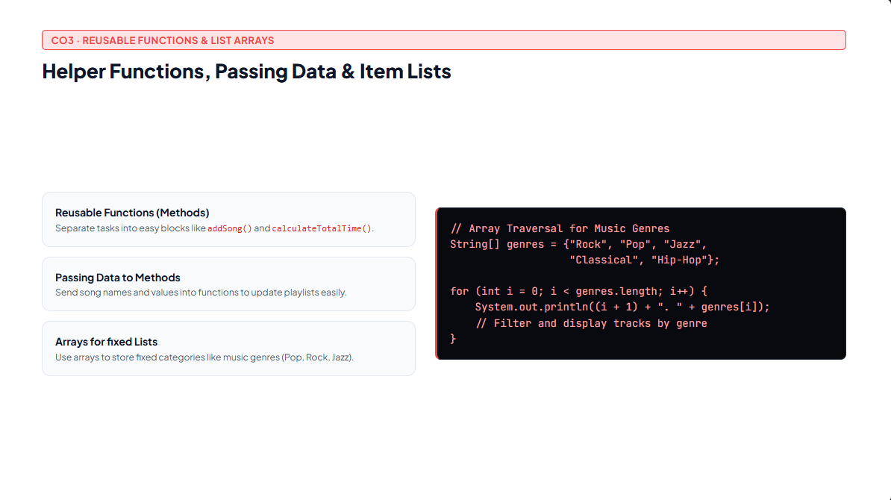

Slide 8
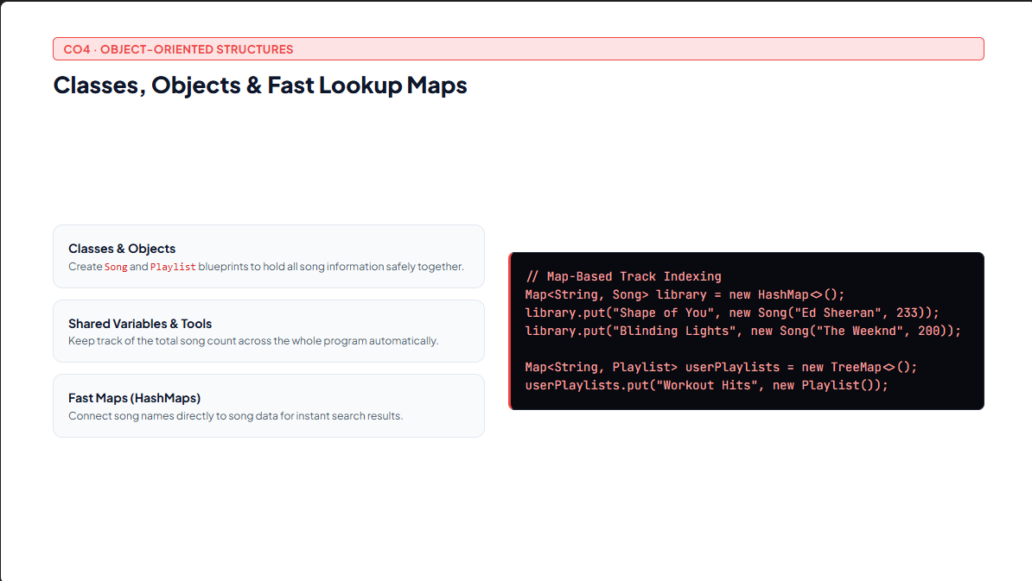

Slide 9
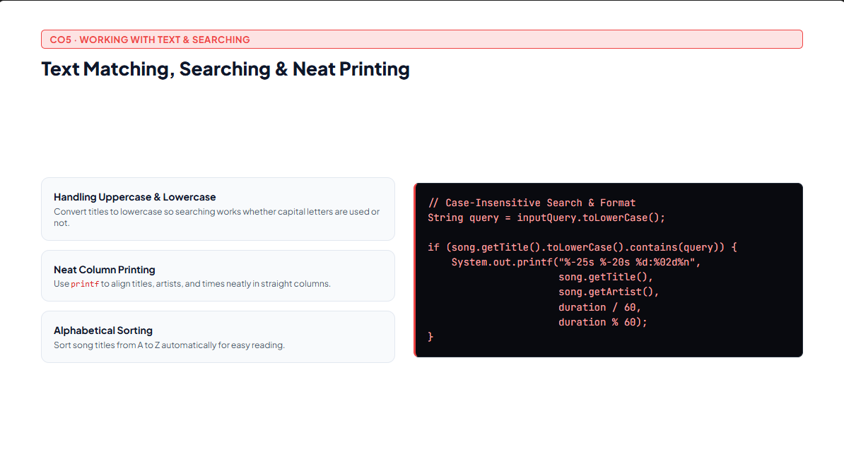

Slide 10
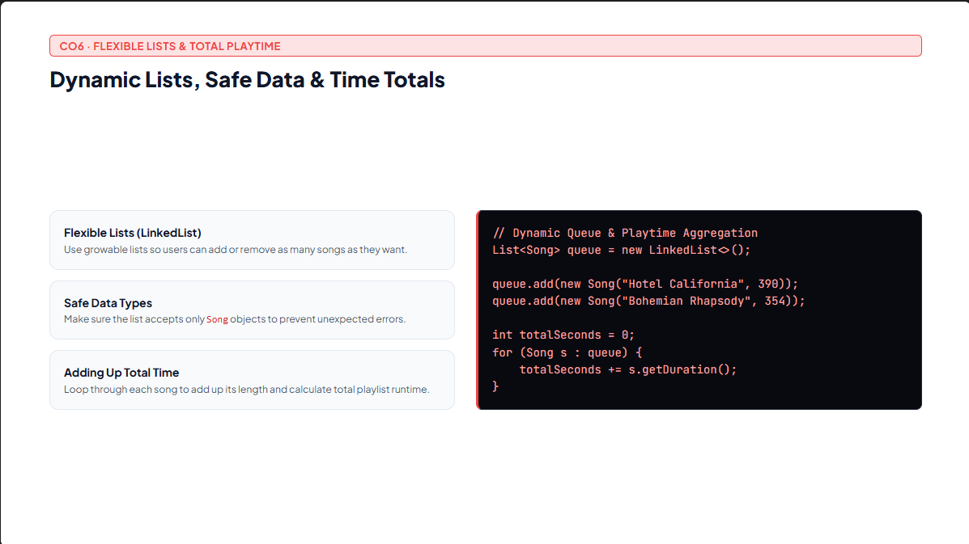

Slide 11
PROGRAM SCREENSHOT / DEMO
How the Console Looks
================ SMART MUSIC PLAYLIST MANAGER ===============
Enter Playlist Name: Chill Vibes
Select Action:
1. Add Track | 2. Search Song | 3. Display Playlist | 4. Exit
Enter choice (1-4): 3
================ PLAYLIST: CHILL VIBES =================
TRACK NAME
ARTIST
DURATION
1. Starboy
The Weeknd
3:50
2. Perfect
Ed Sheeran
4:23
3. Night Changes
One Direction
3:46
4. Sunflower
Post Malone
2:38

Slide 12
Summary & Key Takeaways
How the project pieces fit together and what we learned
Main Program Parts
What We Learned
User Menu: Takes choices and inputs on the console screen.
Fast Searching: Using HashMaps and LinkedLists for speed.
Program Logic: Handles search, sorting, and time calculations.
Clean Java Code: Keeping song info organized inside classes.
Data Storage: Keeps songs saved in memory while running.
Error Prevention: Stopping wrong menu picks from crashing the app.
Song Models: Holds details for Song and Playlist.
Clear Reports: Printing neat tables for tracks and song times.

Slide 13

Thank You!
Smart Music Playlist Manager · Java Programming Project
Srihitha (2620080034)
•
Radhika (2620030258)

